Slide 1

Load balancing & HA-Proxy
Team 11

Slide 2
Table of contents
Load balancing
Install & Configuration
HA-Proxy
Demo

Slide 3
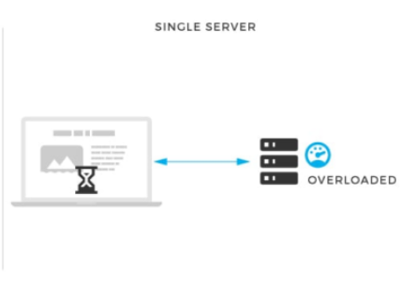
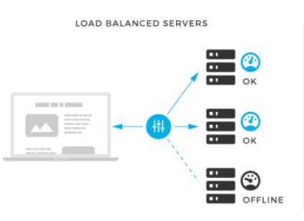
Context
Solution
What if the single server go down or overload?
The user connects directly to your web server, at yourdomain.com

Slide 4
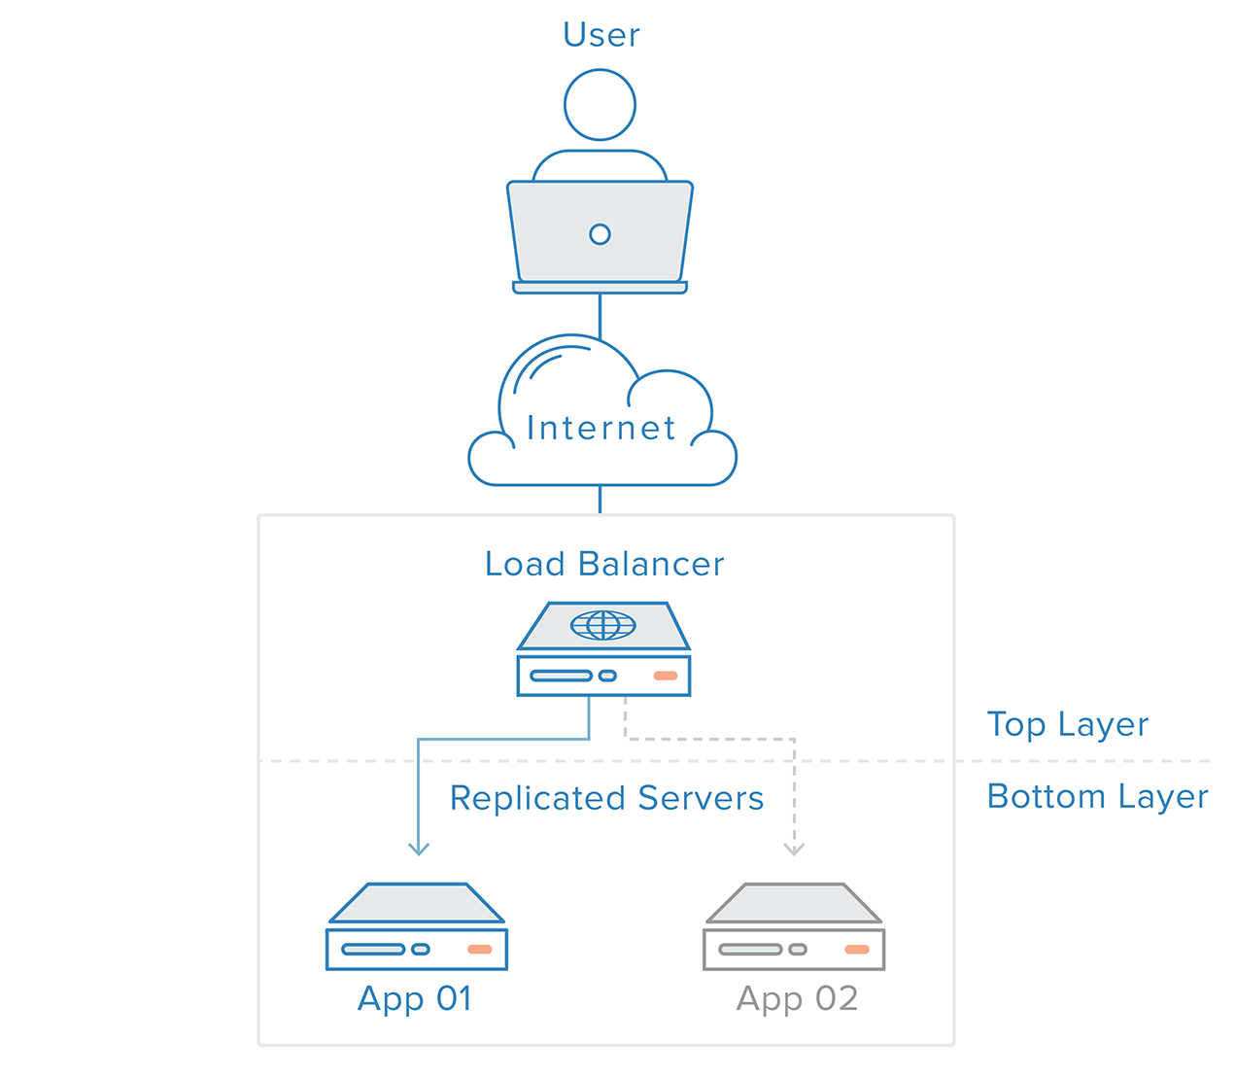
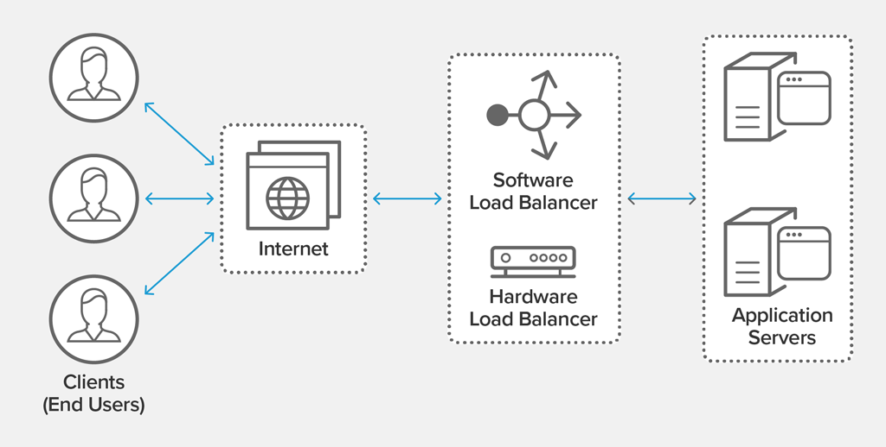
Load balancing
Load balancing refers to efficiently distributing incoming network traffic across a group of backend servers, also known as a server farm or server pool.
What Is Load Balancing? How Load Balancers Work (nginx.com)

Slide 5
Benefits of load balancing
Reduced downtime
Scalable
Redundancy
Flexibility
Efficiency

Slide 6

HIGH AVAilability proxy

Slide 7
introduction
HAProxy, which stands for High Availability Proxy, is a popular open source software TCP/HTTP Load Balancer and proxying solution which can be run on Linux, macOS, and FreeBSD.

Slide 8
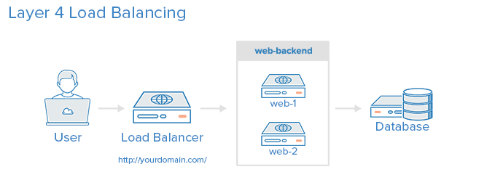
Layer 4 Load Balancing
Load balancing this way will forward user traffic based on IP range and port.

Slide 9
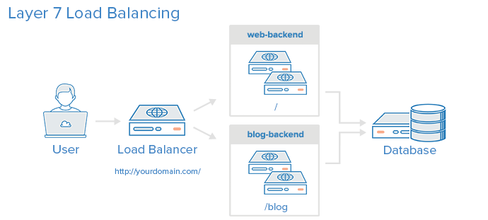
Layer 7 Load Balancing
More complex. Using layer 7 allows the load balancer to forward requests to different backend servers based on the content of the user’s request.
=> Run multiple web application servers under the same domain and port.

Slide 10
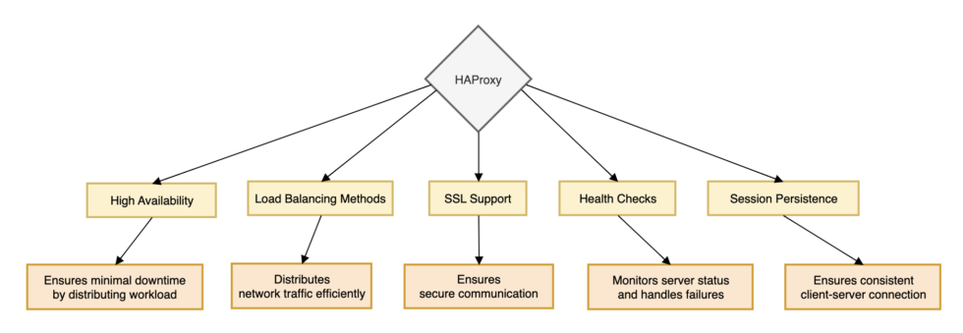
Key features of HAProxy:

Slide 11
HAPROXY Load balancing algorithms
1
2
3
4
5
6
URL Parameter
Requests are distributed across the group of servers sequentially, according to its weight.
Round Robin
Static Round Robin
Least Connection
Source
This algorithm hashes either the left part of the URI, or the whole URI and divides the hash value by the total weight of running servers
Similar to RR, but changing weight is not allowed
A new request is sent to the server with the fewest current connections to clients.
URI
This algorithm hashes the source IP and divides it by the total weight of running servers.
This algorithm hashes the value of parameter in GET request and divided by the total weight of running servers.

Slide 12




HAProxy use cases in real world
1. use HAProxy for MySQL load balancing.
2. use HAProxy to handle millions of concurrent connections.
3. uses HAProxy to manage its global traffic and ensure high availability of its services.

Slide 13
Install and Configuration haproxy

Slide 14


Haproxy install and Start
Install haproxy
using terminal
Update version
Start service
How to Install HAProxy on Ubuntu (In a Few Simple Steps)

Slide 15
Haproxy configuration
Global
Default
Frontend
Backend

Slide 16
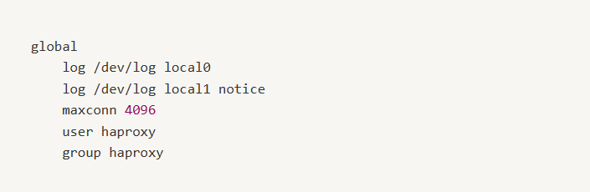
1. Global section: This section contains global settings for HAProxy, such as maximum connections, default log format, and process management settings.

Slide 17
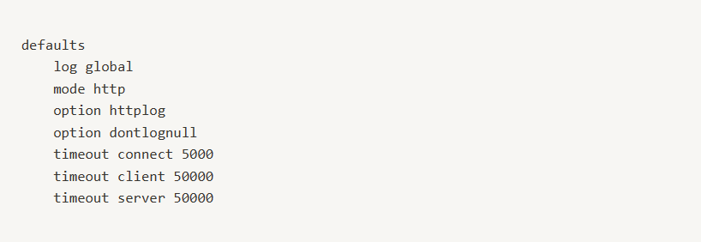
2. Default section: This section defines default parameters for all frontend and backend sections.

Slide 18
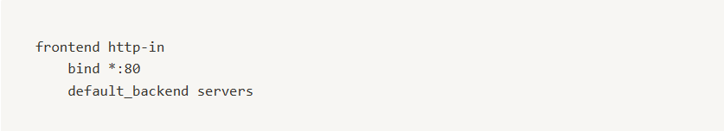
3. Frontend section: Frontend sections define how HAProxy handles incoming traffic.

Slide 19
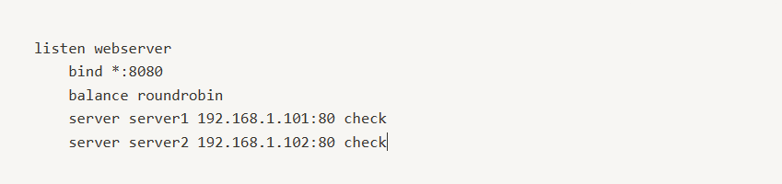
4. Backend section: Backend sections are used to define server pools, load balancing algorithms, and server health checks.

Slide 20

Demo

Slide 21
DEMO1: For Understanding algorithms
Link demo: https://tinyurl.com/yr2dql7y

Slide 22
DEMO2: haproxy for webserver and database
Link demo: https://drive.google.com/file/d/1Ukb8q1wdnYYxQLmxE-O6tOQ0Qy_KR3RU/view?usp=sharing

